Slide 1
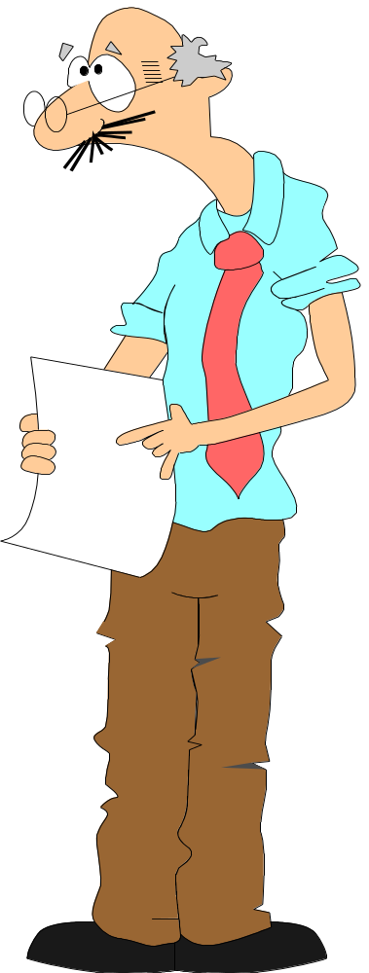

Do’s and Taboos of Effective Presentations
Presented by:
Ken Nixon
Acknowledgment: Thanks are extended to IDC Technologies for permission to use parts of one of their presentations
Notes:
This presentation is a summary of the book
What’s Your Point? By Bob Boylan
Simply put, this book is for business people who wish to become better presenters.

Slide 2


Just so you know…
Good speakers are “made”, not “born”
  Is anyone “born” a good Athlete or Doctor?
You can control and manage nervousness, but you can’t eliminate it.
  It will decrease over time.
  Nervousness is self-centered.
  The audience is not out to get you. They want you to succeed.

Slide 3

Three Points To Remember
Focused content
Correct content
Commitment to content
Notes:
There is a wide difference between a person’s competence and a person’s effectiveness based on their ability to communicate verbally. To become a better presenter, there are just three things to remember:
Focused content
Correct content
Commitment to the content
A presentation should not be viewed as information sharing. You don’t want it to end with the audience just saying, “Thank you.” You expect something to happen. By definition, a presentation is where you ask somebody to agree with you, to make a decision, or to do something.

Slide 4

Have a Strong Beginning & Ending
Openings:
  Startling statement
  Surprising action
  Question
  Personal experience
  Purpose statement
  Humor
Endings:
  End with purpose. Don’t be like a car that runs out of gas in the middle of nowhere.
Know where you’re starting, where you’re going, and lead people to a strong conclusion.

Slide 5

Structure Your Presentation
There are three parts to any speech:
  Tell them what you’re going to tell them,
  Tell them,
  Tell them what you just told them.
People need a ‘roadmap’ to establish their expectations.
  If they have to guess what your speech is about, they’ll get confused and stop listening.

Slide 6

BVE
Brevity
  Brevity breaks boredom.
Variety
  Variety adds vitality.
  Listeners drift in and out by nature.
Entertainment
  Entertainment engages.
  Adults prefer to be entertained,
  not lectured.
  Make your presentation an experience.

Slide 7
Data vs. Information
Specification 44%
Changes after commissioning 20%
Design & implementation 15%
Operations & maintenance 15%
Installation 6%
This is “data”

Slide 8
Use graphics instead
Changes After Commissioning 20%
Specification 44%
Operations & Maintenance 15%
Installation & Commissioning 6%
Design & Implementation 15%
This is “information”

Slide 9

Colour
Light text on dark background.
  Best for slides.
  Disadvantage is that the lights must be turned very low.
Dark text on light background.
  Best for electronic presentations and overheads.
  Lights do not have to be turned down.
Be careful about colour combinations!
Notes:
In addition to the above, if you’re using PowerPoint, I suggest the following:
Use a consistent transition between slides.
Have the bullet points build, so you can talk about one at a time.
Have a graphic for each slide that reinforces the topic.
Don’t use sound effects - they only draw the focus away from you.

Slide 10
One UGLY Slide!
Terrible color combination. Hard on the eyes!
(Red on blue is the absolute worst colour combination!)
Too much information. People aren’t going to take the time to read to much information. You just want to give people the basic concepts, the highlights, in a slide.
Background images or lines won’t help this!

Slide 11

Questions & Answers
Anticipate & prepare
Listen
  Listen to the entire message.
Repeat or rephrase
  Repeat so others can hear it.
Answer concisely
  No dissertations!
Move on

Slide 12

Use a cheat sheet!
Keep a list of the slide numbers and titles.
Go to any slide by simply typing in that number and pressing “Enter”
(in PowerPoint).
This allows the greatest amount of flexibility (great for Q&A), and is transparent to the audience.

Slide 13
Electronic Presentation Tips
Use a consistent transition between slides.
Don’t overdo animations.
Don’t use simple “canned” sound effects.
  They only draw the focus away from you. (And are usually annoying!)
Notes:
In addition to the above, if you’re using PowerPoint, I suggest the following:
Use a consistent transition between slides.
Have the bullet points build, so you can talk about one at a time.
Have a graphic for each slide that reinforces the topic.
Don’t use sound effects - they only draw the focus away from you.

Slide 14

Body Language
Don’t hide behind a podium.
Keep your hands out of your pockets!
Use all of your body to get a point across.
Film yourself!
  You’ll be amazed at what you see! Also, watch it with the sound turned down.
Notes:
In addition to the above, if you’re using PowerPoint, I suggest the following:
Use a consistent transition between slides.
Have the bullet points build, so you can talk about one at a time.
Have a graphic for each slide that reinforces the topic.
Don’t use sound effects - they only draw the focus away from you.

Slide 15
Voice
Don’t speak in a monotone.
Speak loudly and clearly.
People can listen at a faster rate than you can speak.
Record yourself.
  You’ll hear things on tape you never noticed before!
Notes:
In addition to the above, if you’re using PowerPoint, I suggest the following:
Use a consistent transition between slides.
Have the bullet points build, so you can talk about one at a time.
Have a graphic for each slide that reinforces the topic.
Don’t use sound effects - they only draw the focus away from you.

Slide 16

Taboo #1
Font sizes too small.
Slides that contain too much information might be great as handouts, or as slide “notes”, but make for lousy slides.
KILL: Keep It Large & Legible.
Notes:
In addition to the above, if you’re using PowerPoint, I suggest the following:
Use a consistent transition between slides.
Have the bullet points build, so you can talk about one at a time.
Have a graphic for each slide that reinforces the topic.
Don’t use sound effects - they only draw the focus away from you.

Slide 17


Taboo #2
Overly complex graphics.
Simplify!

Slide 18
Taboo #3
Never turn your back on your audience.
Display on your computer as well as the screen, so you don’t have to turn around.

Slide 19

Taboo #4
Don’t read your slides.
  It’s BORING!!
  You loose eye contact.
  You won’t be viewed as an expert.
Don’t read your paper.
  It’s BORING!!
  You sound canned.

Slide 20
Final Thoughts
If you don’t rehearse, don’t present.
Learn from other good speakers.
  You won’t become a championship skier by skiing with your peers.

